Slide 1
Chapter 6: CPU Scheduling
Notes:
‹#›

Slide 2
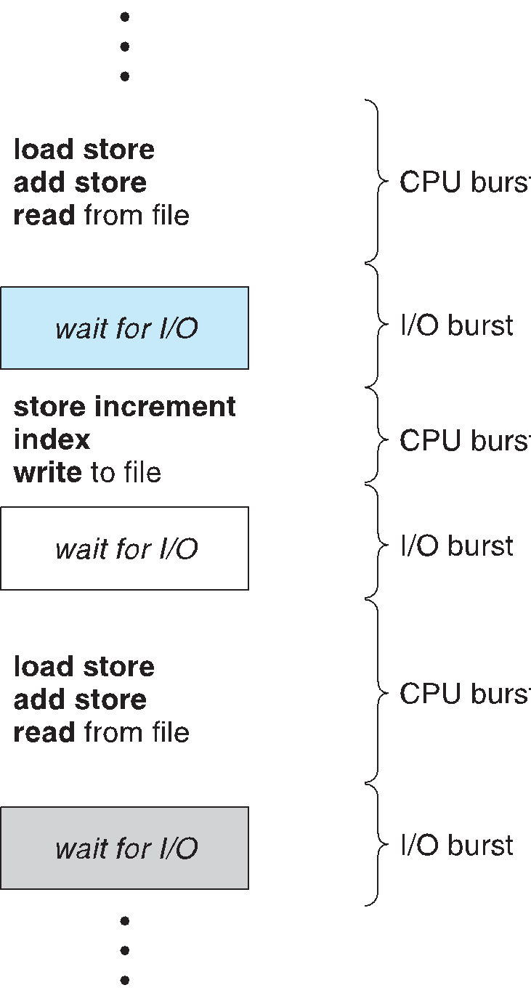
Basic Concepts
Maximum CPU utilization obtained with multiprogramming
CPU–I/O Burst Cycle – Process execution consists of a cycle of CPU execution and I/O wait
CPU burst followed by I/O burst
CPU burst distribution is of main concern
Notes:
‹#›

Slide 3
CPU Scheduler
Short-term scheduler selects among the processes in ready queue, and allocates the CPU to one of them
  Queue may be ordered in various ways
CPU scheduling decisions may take place when a process:
  1. Switches from running to waiting state
  2. Switches from running to ready state
  3. Switches from waiting to ready
  4. Terminates
Scheduling under 1 and 4 is nonpreemptive
All other scheduling is preemptive
  Consider access to shared data
  Consider preemption while in kernel mode
  Consider interrupts occurring during crucial OS activities
Notes:
‹#›

Slide 4
Dispatcher
Dispatcher module gives control of the CPU to the process selected by the short-term scheduler; this involves:
  switching context
  switching to user mode
  jumping to the proper location in the user program to restart that program
Dispatch latency – time it takes for the dispatcher to stop one process and start another running
Notes:
‹#›

Slide 5
Scheduling Criteria
CPU utilization – keep the CPU as busy as possible
Throughput – number of processes that complete their execution per time unit
Turnaround time – amount of time to execute a particular process
Waiting time – amount of time a process has been waiting in the ready queue
Response time – amount of time it takes from when a request was submitted until the first response is produced, not output (for time-sharing environment)
Notes:
‹#›

Slide 6
Scheduling Algorithm Optimization Criteria
Max CPU utilization
Max throughput
Min turnaround time
Min waiting time
Min response time
Notes:
‹#›

Slide 7
First-Come, First-Served (FCFS) Scheduling
Process Burst Time
P₁ 24
P₂ 3
P₃ 3
Suppose that the processes arrive in the order: P₁ , P₂ , P₃
The Gantt Chart for the schedule is:
Waiting time for P₁ = 0; P₂ = 24; P₃ = 27
Average waiting time: (0 + 24 + 27)/3 = 17
P₁
P₂
P₃
0
24
27
30
Notes:
‹#›

Slide 8
FCFS Scheduling (Cont.)
Suppose that the processes arrive in the order:
P₂ , P₃ , P₁
The Gantt chart for the schedule is:
Waiting time for P₁ = 6; P₂ = 0; P₃ = 3
Average waiting time: (6 + 0 + 3)/3 = 3
Much better than previous case
Convoy effect - short process behind long process
  Consider one CPU-bound and many I/O-bound processes
P₂
P₃
P₁
0
3
6
30
Notes:
‹#›

Slide 9
Shortest-Job-First (SJF) Scheduling
Associate with each process the length of its next CPU burst
  Use these lengths to schedule the process with the shortest time
SJF is optimal – gives minimum average waiting time for a given set of processes
  The difficulty is knowing the length of the next CPU request
  Could ask the user
Notes:
‹#›

Slide 10
Example of SJF (Without AT)
Process Burst Time
P₁ 6
P₂ 8
P₃ 7
P₄ 3
SJF scheduling chart
Average waiting time = (3 + 16 + 9 + 0) / 4 = 7
P₄
P₁
P₃
P₂
0
3
9
16
24
Notes:
‹#›

Slide 11
Example of Non-Preemptive SJF
Process Arrival Time Burst Time
P₁ 0.0 7
P₂ 2.0 4
P₃ 4.0 1
P₄ 5.0 4
SJF (non-preemptive)
Average waiting time = (0 + 6 + 3 + 7)/4 = 4
P₁
P₃
P₂
P₄
0
3
7
8
12
16
Notes:
‹#›

Slide 12
Shortest-remaining-time-first
Now we add the concepts of varying arrival times and preemption to the analysis
ProcessA arriArrival TimeT Burst Time
P₁ 0 8
P₂ 1 4
P₃ 2 9
P₄ 3 5
Preemptive SJF Gantt Chart
P₁
P₂
P₄
P₁
P₃
10
17
26
0
1
1
5
5
Notes:
‹#›

Slide 13
Shortest-remaining-time-first
Turn Around time = Completion time – Arrival time
Waiting Time = Turnaround time – Burst time
Response Time = CPU First Time – Arrival Time
Average waiting time = [9 + 0 + 15 + 2] / 4 = 26 / 4 = 6.5 msec
Process | Turnaround Time | Waiting Time
P₁ | 17 - 0 = 17 | 17 - 8 = 9
P₂ | 5 - 1 = 4 | 4 - 4 = 0
P₃ | 26 - 2 = 24 | 24 - 9 = 15
P₄ | 10 - 3 = 7 | 7 - 5 = 2

Slide 14
Priority Scheduling
A priority number (integer) is associated with each process
The CPU is allocated to the process with the highest priority (smallest integer ≡ highest priority)
  Preemptive
  Nonpreemptive
SJF is priority scheduling where priority is the inverse of predicted next CPU burst time. Execute each process for 1 time quantum if q is not mentioned.
Problem ≡ Starvation – low priority processes may never execute
Solution ≡ Aging – as time progresses increase the priority of the process
Notes:
‹#›

Slide 15
Example of Priority Scheduling
ProcessA arri Burst TimeT Priority
P₁ 10 3
P₂ 1 1
P₃ 2 4
P₄ 1 5
P₅ 5 2
Priority scheduling Gantt Chart
Average waiting time = 8.2 msec
P₂
P₅
P₁
P₃
P₄
0
1
6
16
18
19
Notes:
‹#›

Slide 16
Example of Priority Scheduling
Consider higher number as high priority
Priority | Process | Arrival Time | Burst Time
10 | P1 | 0 | 5
20 | P2 | 1 | 4
30 | P3 | 2 | 2
40 | P4 | 4 | 1
Gantt Chart
P1 | P2 | P3 | P3 | P4 | P2 | P1
0 1 2 3 4 5 8 12

Slide 17
Round Robin (RR)
Each process gets a small unit of CPU time (time quantum q), usually 10-100 milliseconds. After this time has elapsed, the process is preempted and added to the end of the ready queue.
If there are n processes in the ready queue and the time quantum is q, then each process gets 1/n of the CPU time in chunks of at most q time units at once. No process waits more than (n-1)q time units.
Timer interrupts every quantum to schedule next process
Performance:
  q large ⇒ FIFO
  q small ⇒ q must be large with respect to context switch, otherwise overhead (wastes CPU cycles) is too high
Notes:
‹#›

Slide 18
Example of RR with Time Quantum
Process Burst Time
P₁ 24
P₂ 3 q = 4
P₃ 3
The Gantt chart is:
Typically, higher average turnaround than SJF, but better response
q should be large compared to context switch time
q usually 10ms to 100ms, context switch < 10 usec
usec -> microsecond
P₁
P₂
P₃
P₁
P₁
P₁
P₁
P₁
0
4
10
14
18
22
26
30
Notes:
‹#›

Slide 19
Example of RR with Time Quantum
Process | Arrival Time | Burst Time
P1 | 0 | 5
P2 | 1 | 4
P3 | 2 | 2
P4 | 4 | 1
Ready Queue
P1 | P2 | P3 | P1 | P4 | P2 | P1
Gantt Chart
P1 | P2 | P3 | P1 | P4 | P2 | P1
0 2 4 6 8 9 11 12

Slide 20
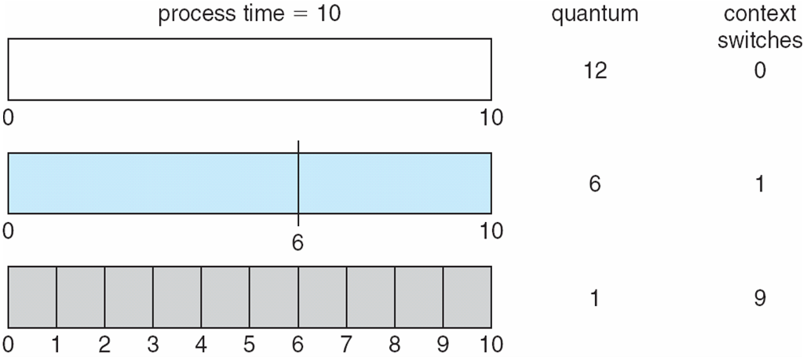
Time Quantum and Context Switch Time
Notes:
‹#›

Slide 21
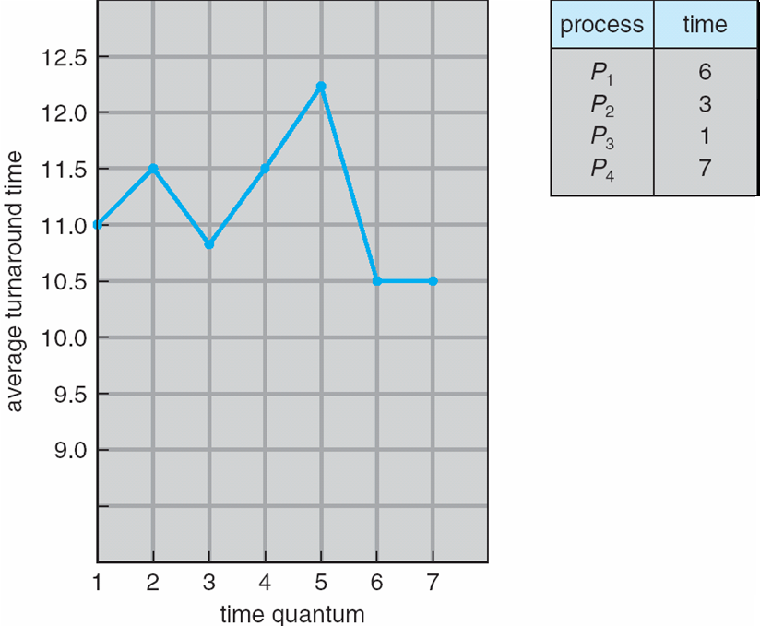
Turnaround Time Varies With
The Time Quantum
80% of CPU bursts should be shorter than q
Notes:
‹#›

Slide 22
End of Chapter 6
Notes:
‹#›

